Slide 1
PythonDS-05_1 Stats for Data Science
Dr. Naveen Kumar
Associate Professor
Amity Institute of Information Technology
Amity University Patna

Slide 2
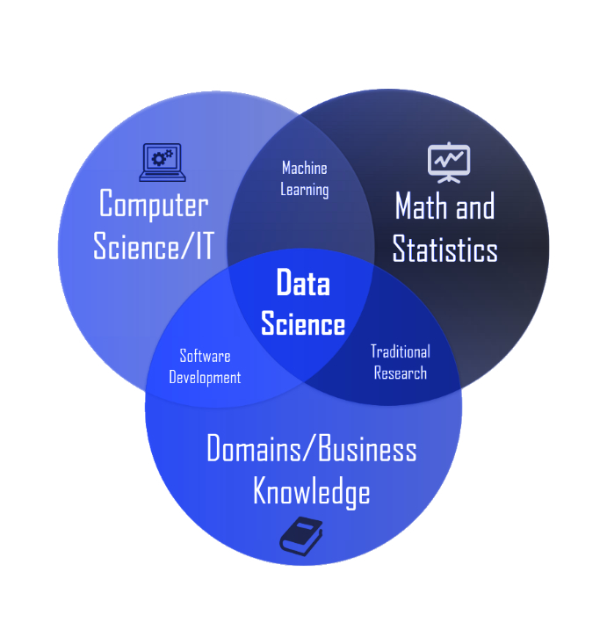

Slide 3
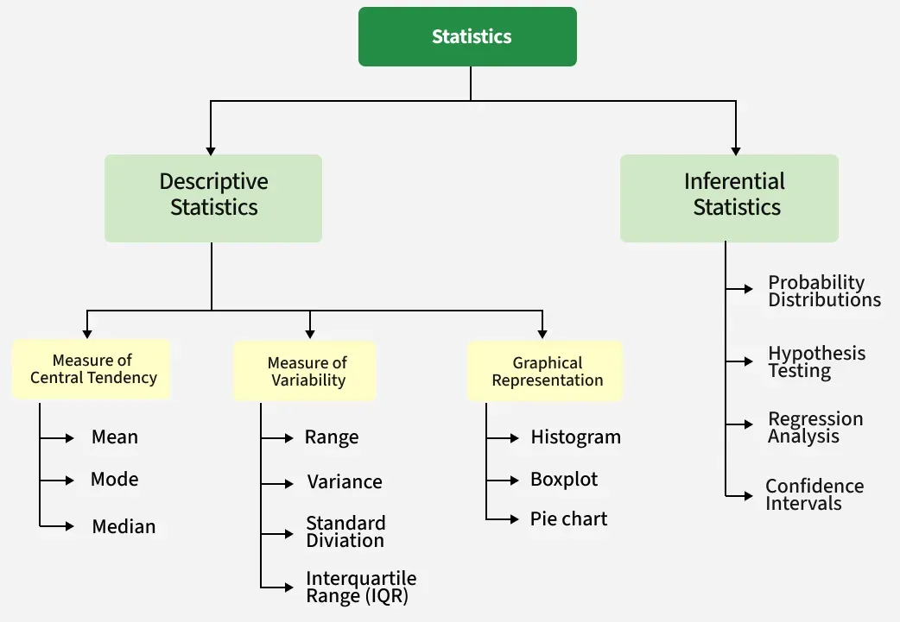

Slide 4
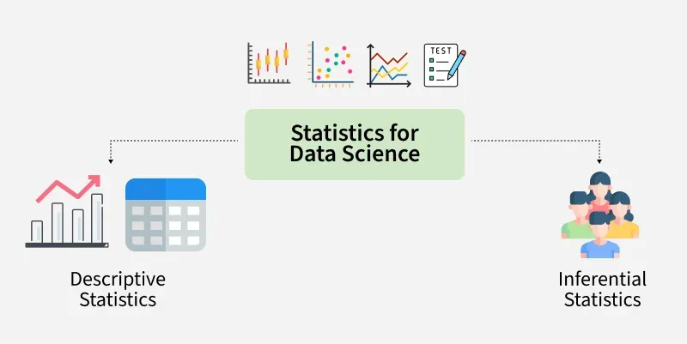

Slide 5
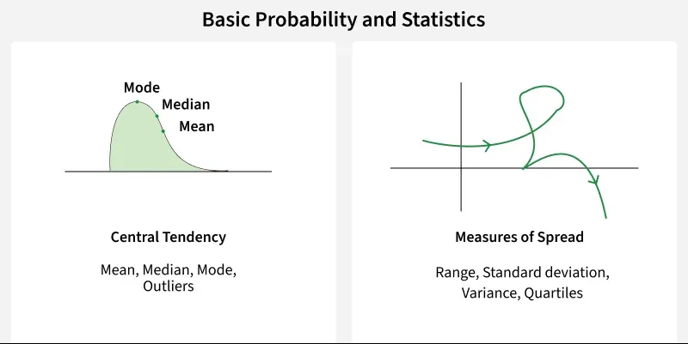

Slide 6
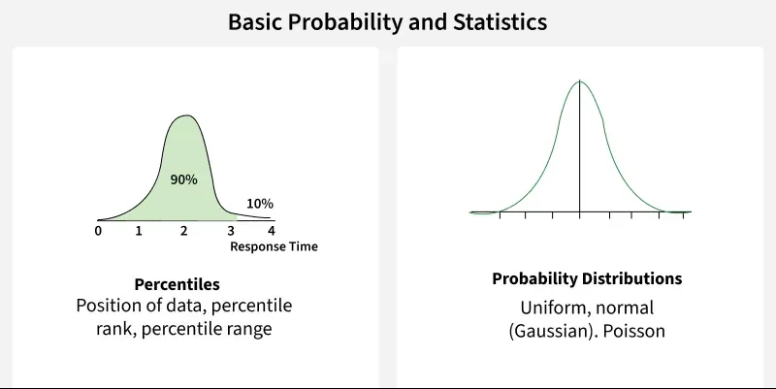

Slide 7
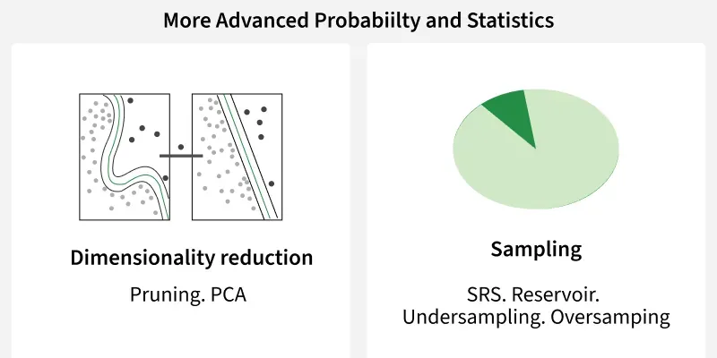

Slide 8
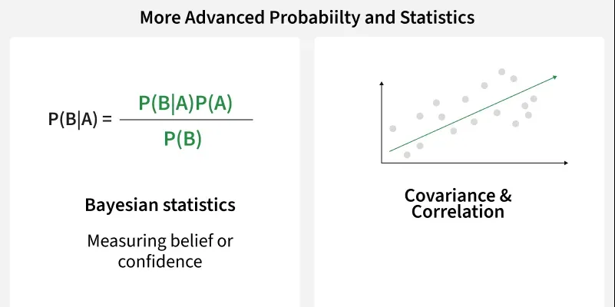

Slide 9
Two Types of Statistics
Descriptive Statistics: De­scriptive Statistics helps us simplify and organize big chunks of data. This makes large amounts of data easier to understand.
Inferential Statistics: Inferential Statistics is a little different. It uses smaller data to conclude a larger group. It helps us predict and draw conclusions about a population.

Slide 10
Types of Data
1. Qualitative Data: This data is descriptive. For example - She is beautiful, He is tall, etc.
2. Quantitative Data: This is numerical information. For example- A horse has four legs.
Discrete Data: It has a particular fixed value and can be counted.
Continuous Data: It is not fixed but has a range of data and can be measured.

Slide 11
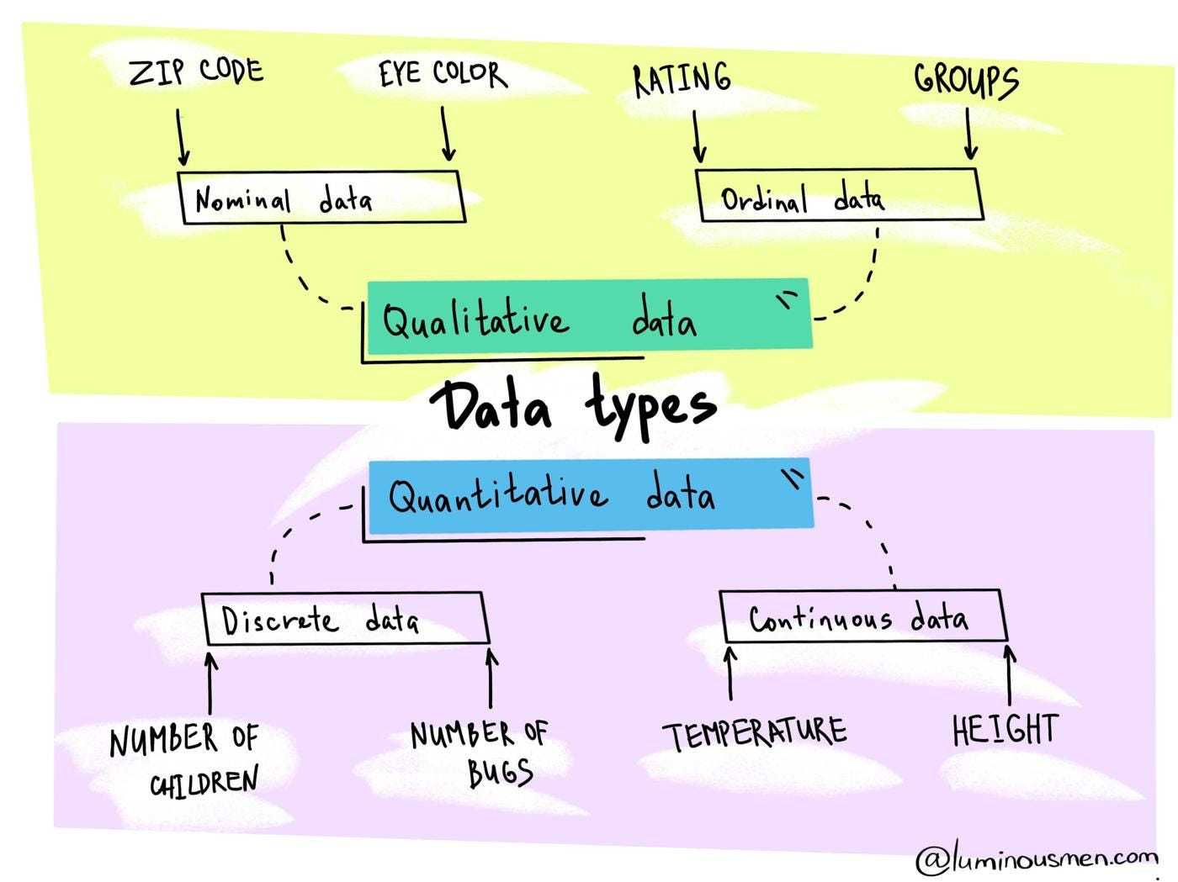

Slide 12
Descriptive Statistics
A. Measures of Central Tendency (Chapter 3)
1. Mean
2. Median
3. Mode
B. Measures of Variability (Chapter 4)
1. Range
2. Mean deviation
3. Variance
4. Standard Deviation
C. Skewness (Chapter 2)
1. Positive skew
2. Normal distribution
3. Negative skew
D. Kurtosis
1. Platykurtic
2. Mesokurtic
3. Leptokurtic

Slide 13
Measure of Central Tendency
1. Mean: The mean can be calculated by summing all values present in the sample divided by total number of values present in the sample or population.
Formula:Mean(μ)=SumofValuesNumberofValues Formula:Mean(μ)=NumberofValuesSumofValues​
2. Median: The median is the middle of a dataset when arranged from lowest to highest or highest to lowest in order to find the median, the data must be sorted. For an odd number of data points the median is the middle value and for an even number of data points median is the average of the two middle values.
3. Mode: The most frequently occurring value in the Sample or Population is called as Mode.​
Measure of Dispersion
Range: Range is the difference between the maximum and minimum values of the Sample.
Variance (σ²): Variance is a measure of how spread-out values from the mean by measuring the dispersion around the Mean.
Formula:σ2 = Σ(X−μ)2n Formula:σ2 = nΣ(X−μ)2​
Standard Deviation (σ): Standard Deviation is the square root of variance. The measuring unit of S.D. is same as the Sample values' unit. It indicates the average distance of data points from the mean and is widely used due to its intuitive interpretation.
Formula:σ=(σ2)=(Σ(X−μ)2n)Formula:σ=(​σ2)=(​nΣ(X−μ)2​)

Slide 14
Measure of Central Tendency
Interquartile Range (IQR): The range between the first quartile (Q1) and the third quartile (Q3). It is less sensitive to extreme values than the range. To compute IQR, calculate the values of the first and third quartile by arranging the data in ascending order. Then, calculate the mean of each half of the dataset.
Formula:IQR=Q3−Q1Formula:IQR=Q3​−Q1​Quartiles: Quartiles divides the dataset into four equal parts:
Q1 (First Quartile): Median of the lower 50% of the dataset (25th percentile).
Q2 (Second Quartile / Median): Median of the entire dataset (50th percentile).
Q3 (Third Quartile): Median of the upper 50% of the dataset (75th percentile).
Mean Absolute Deviation: The average of the absolute differences between each data point and the mean. It provides a measure of the average deviation from the mean.
Formula: MeanAbsoluteDeviation=∑i=1n∣X−μ∣nFormula: MeanAbsoluteDeviation=n∑i=1n​∣X−μ∣​
Coefficient of Variation (CV): CV is the ratio of the standard deviation to the mean, expressed as a percentage. It is useful for comparing the relative variability of different datasets.
CV=(σμ)∗100CV=(μσ​)∗100

Slide 15
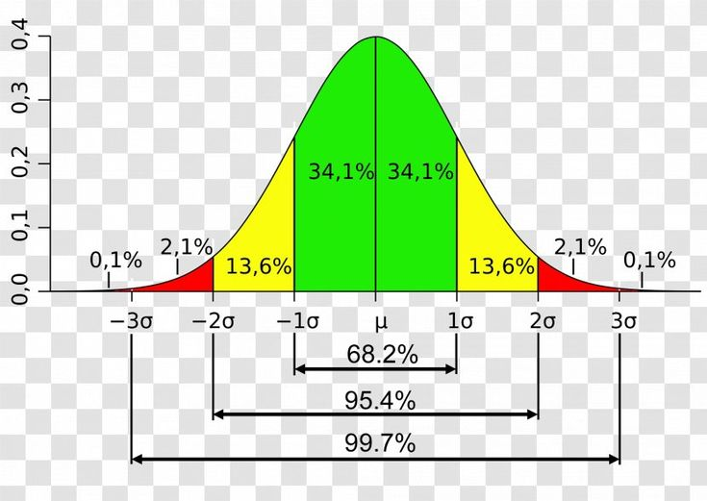

Slide 16
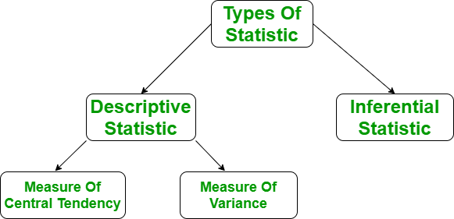

Slide 17
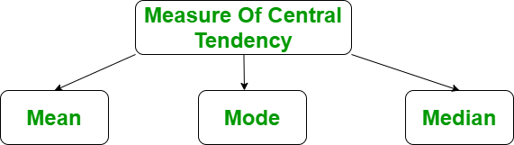

Slide 18
